Slide 2
Audun Hagen Devoteam M Cloud
Azure Enterprise Scale and beyond with GitOps

Slide 3
What is the measurement of success for an IT project?
Adoption

Slide 4
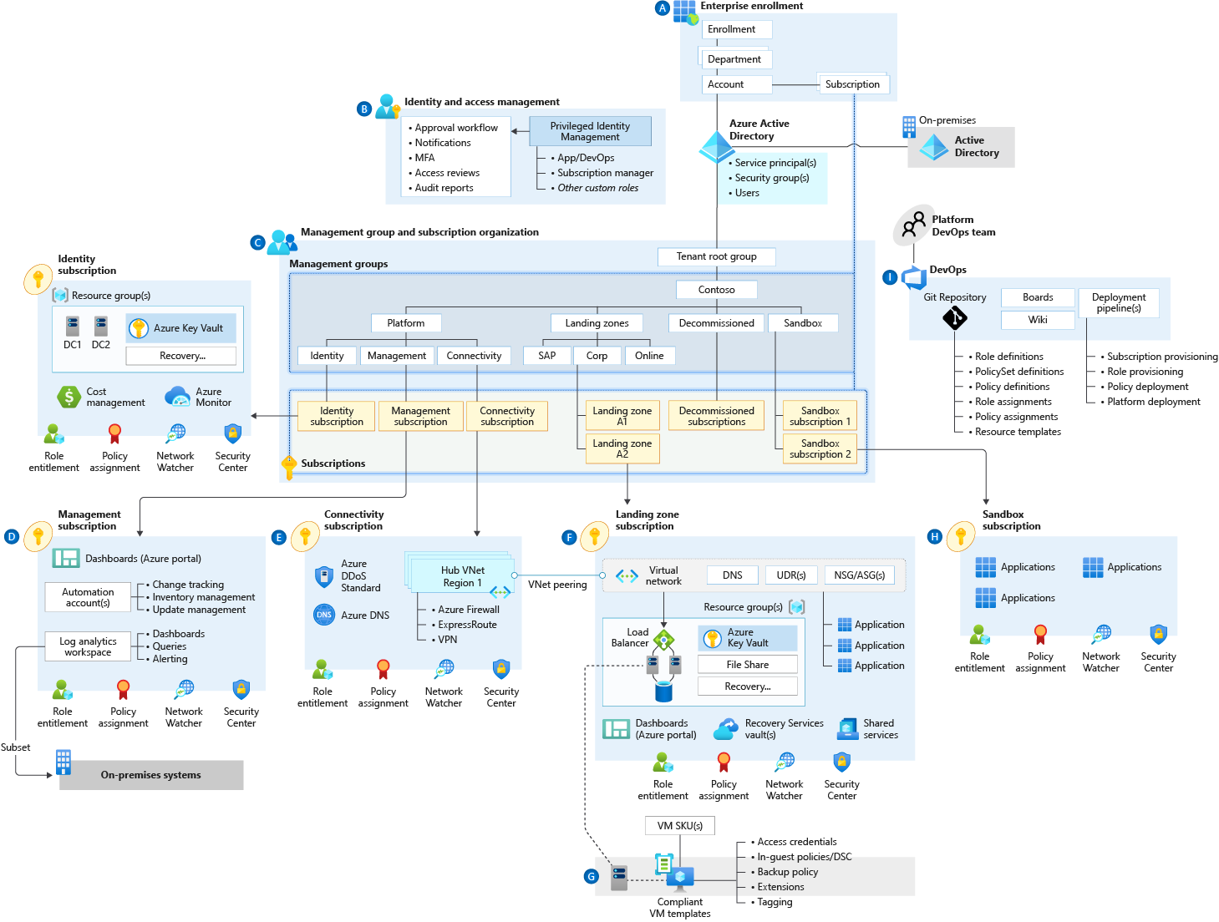
Azure Enterprise Scale

Slide 5
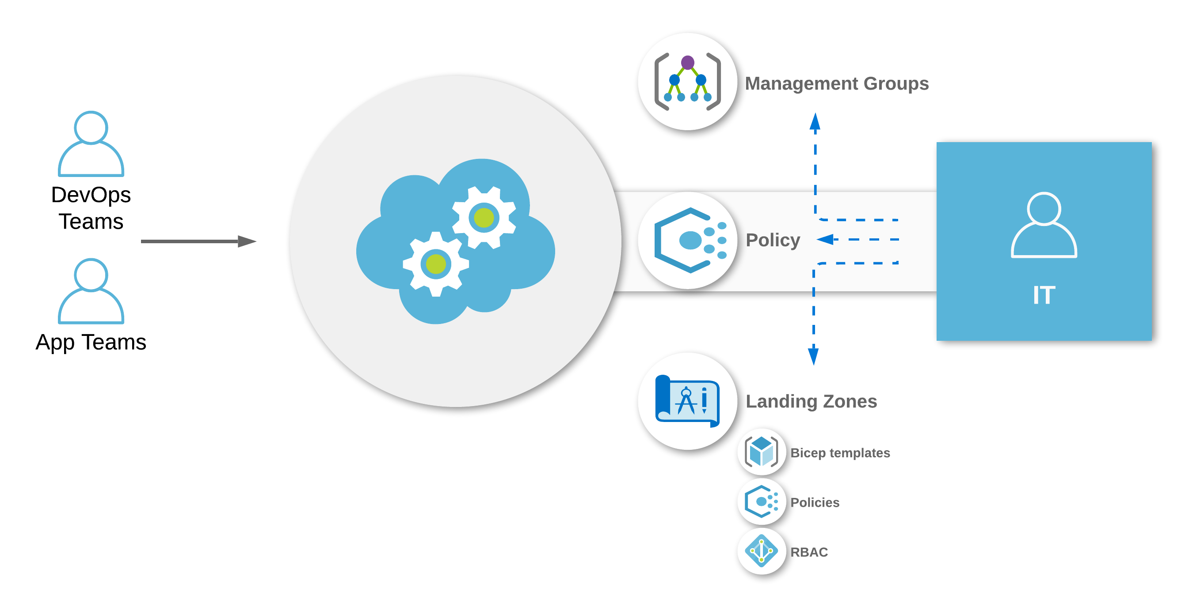

Slide 6

https://github.com/Azure/Enterprise-Scale

Slide 7
Lessons learned so far
There is no other way, but the IaC way

Slide 8
Lessons learned so far
There is no other way, but the IaC way
Fear of (big) ARM templates (16000 lines +)

Slide 9
Lessons learned so far
There is no other way, but the IaC way
Fear of (big) ARM templates (16000 lines +)
DINE policies (Deploy If Not Exists) are hard to manage
(And is undermining the declarativeness of IaC)

Slide 10
Lessons learned so far
There is no other way, but the IaC way
Fear of (big) ARM templates (16000 lines +)
DINE policies (Deploy If Not Exists) are hard to manage
(And is undermining the declarativeness of IaC)
You need a lot more policies and policy assignments

Slide 11
Lessons learned so far
There is no other way, but the IaC way
Fear of (big) ARM templates (16000 lines +)
DINE policies (Deploy If Not Exists) are hard to manage
(And is undermining the declarativeness of IaC)
You need a lot more policies and policy assignments
You need a proper method for safely updating and maintaining your platform as code

Slide 12
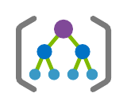



Enterprise Scale IaC elements
Management Groups
Networking
Logging
Policy
https://github.com/Azure/ALZ-Bicep

Slide 13
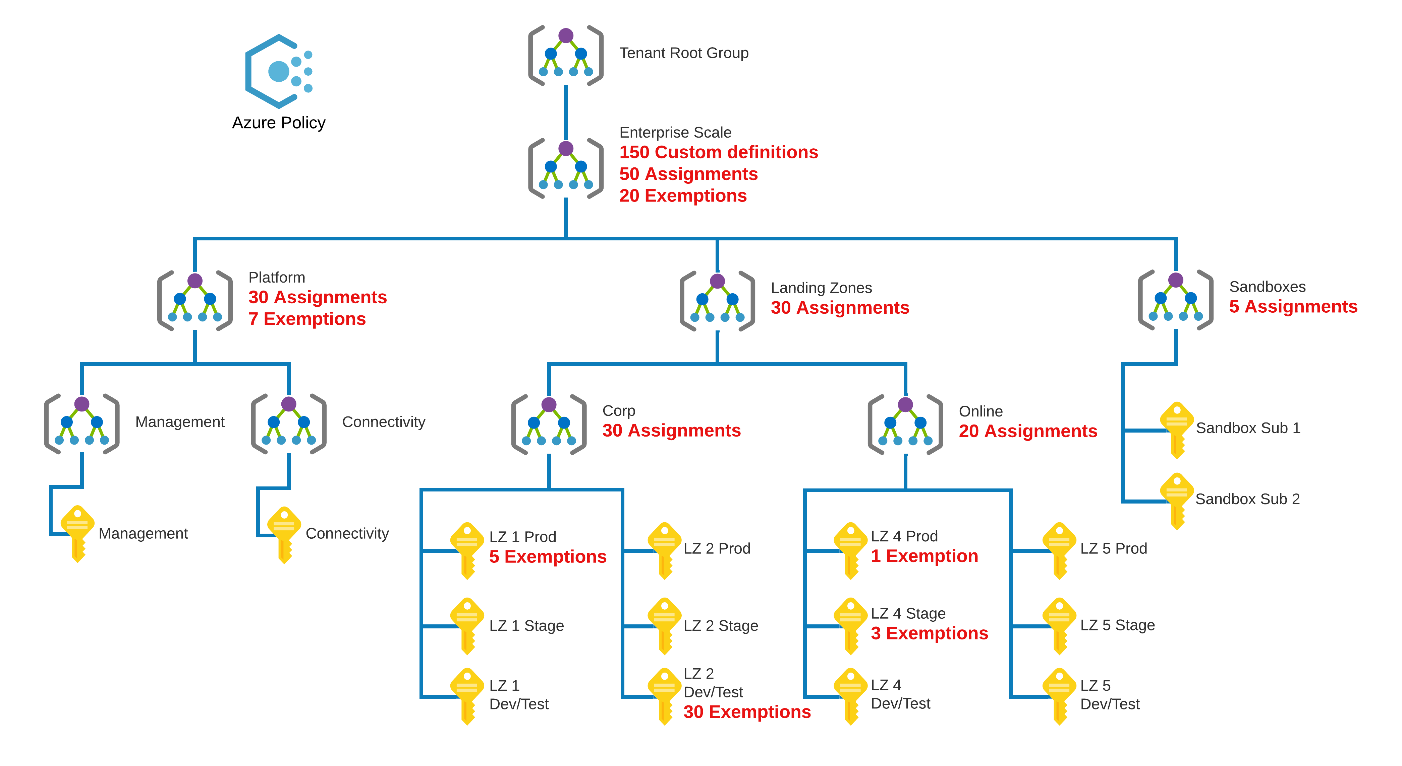

Slide 14
Policy workflow
100% Declarative
Support policies and initiatives
Process policies before initiatives
Support multiple assignments per definition
Support both built-in and custom definitions
Support exemptions
Support cleanup
Easy to use

Slide 15
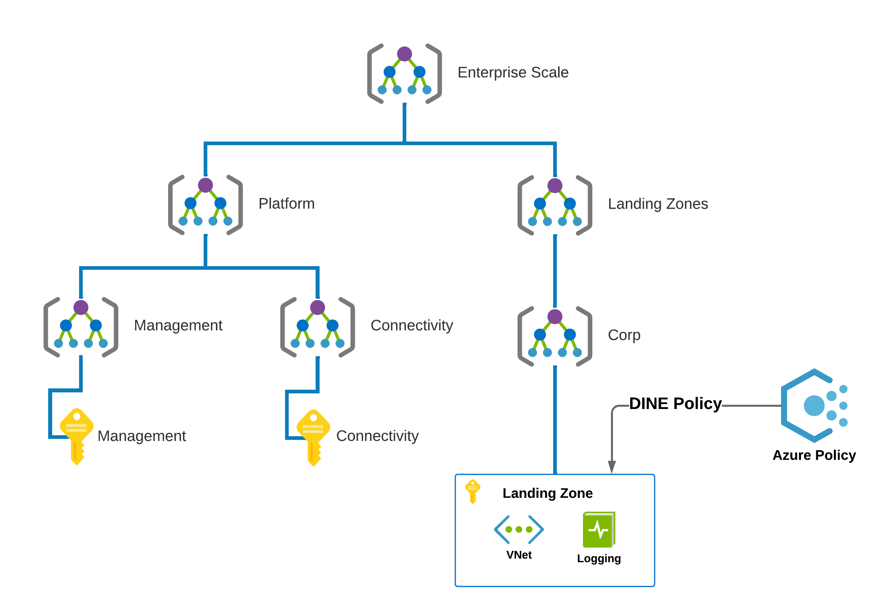
ESLZ Default LZ provisioning

Slide 16
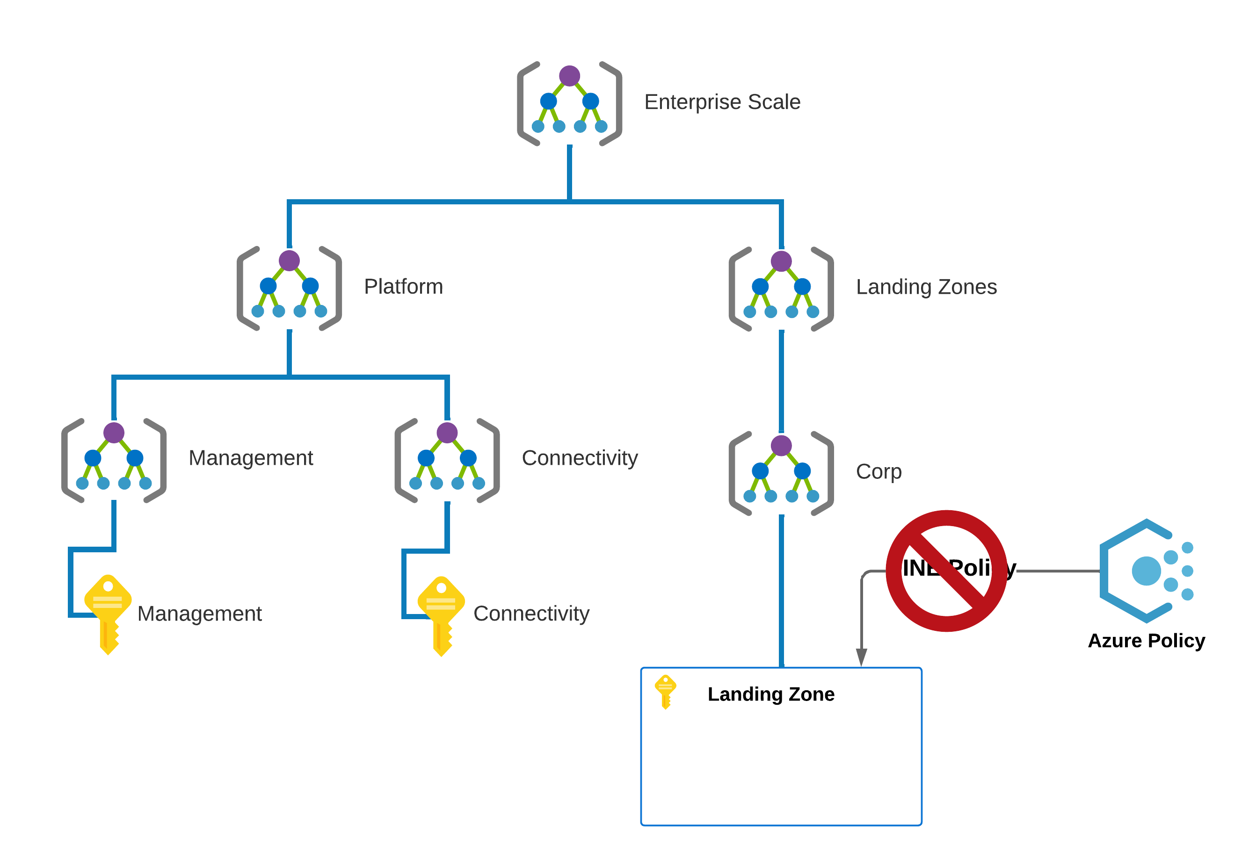
ESLZ Default Landing Zone provisioning

Slide 17
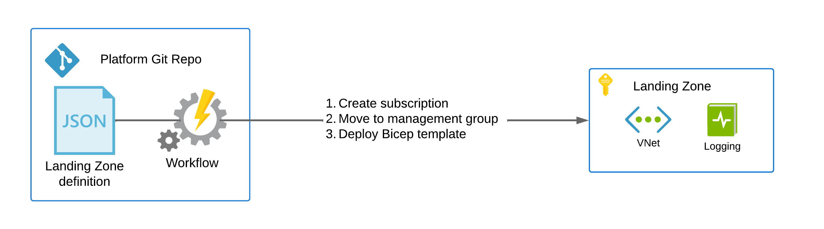
Landing Zone provisioning

Slide 18

Eyes on the price

Slide 19
Landing Zone provisioning

Slide 20
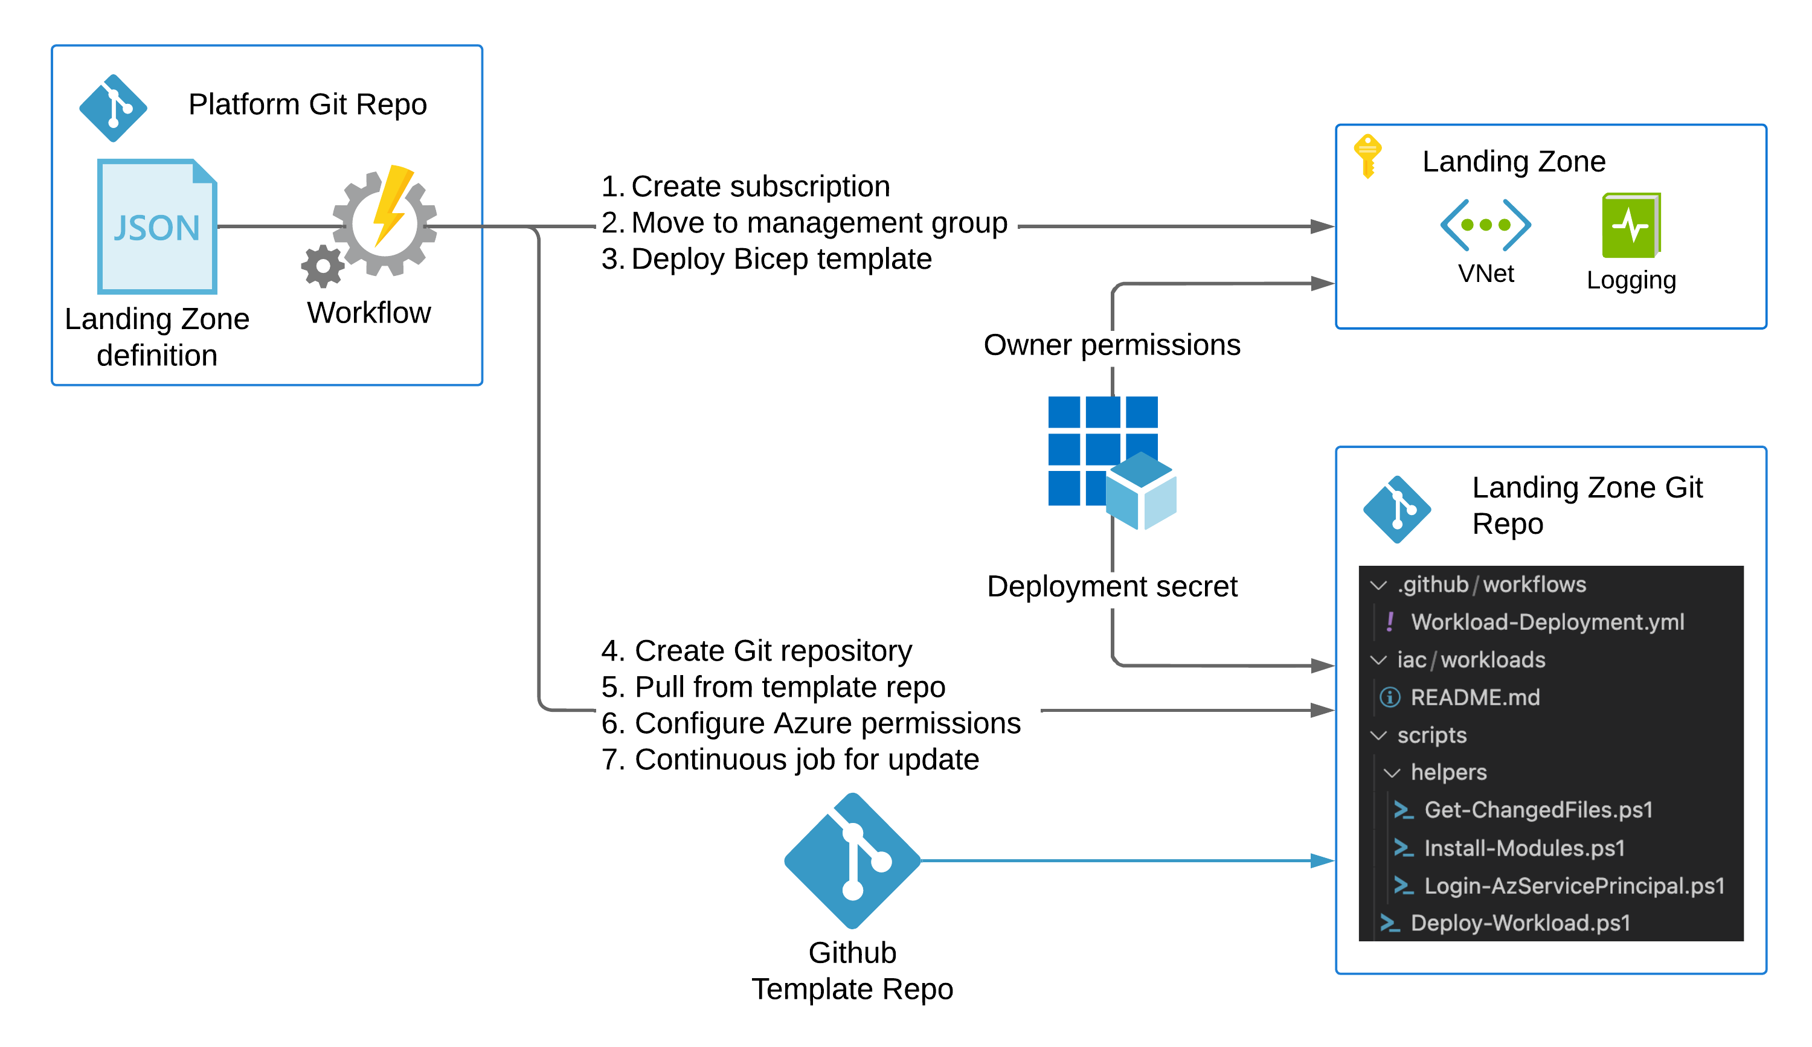

Slide 21


Expectations
Reality

Slide 22
Workload deployment
Opt-in
Structure around workloads

Slide 23
Workload deployment
Opt-in
Structure around workloads
No pipeline management
100% declarative
Multi-template orchestration

Slide 24
Workload deployment
Opt-in
Structure around workloads
No pipeline management
100% declarative
Multi-template orchestration
Support both governed and self-composed templates
Easy to use

Slide 25


What have we learned?
Enterprise Scale
GitOps
Adoption
Just a starting point
Built around “separation of duties”
Equal unit of scale as Azure Landing Zones
“Commoditize” Landing Zone repos
Landing Zones for the organization, not IT
Building blocks and ”paved roads”

Slide 26

But this one goes to 11

Slide 27
Slides and demos from the conference will be available at
https://github.com/nordicinfrastructureconference/2022

Slide 28
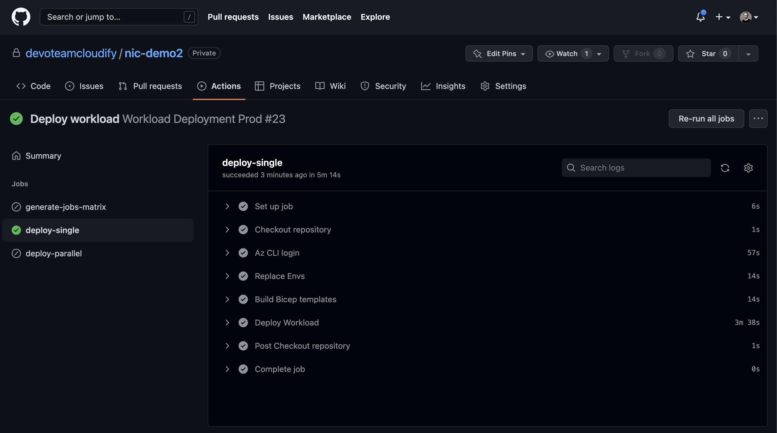
Notes:
Emergency slides

Slide 29
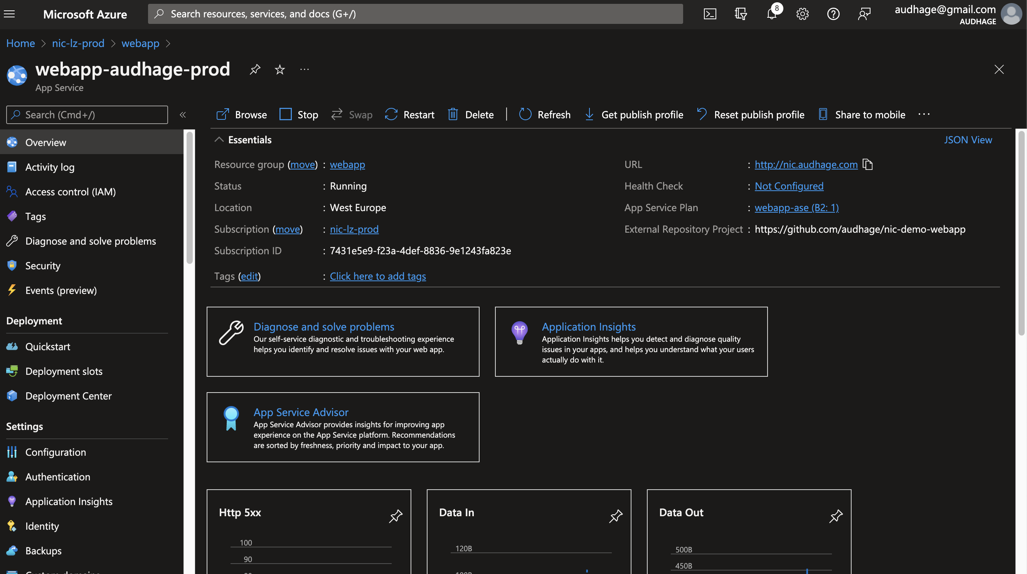
Notes:
Emergency slides

Slide 30
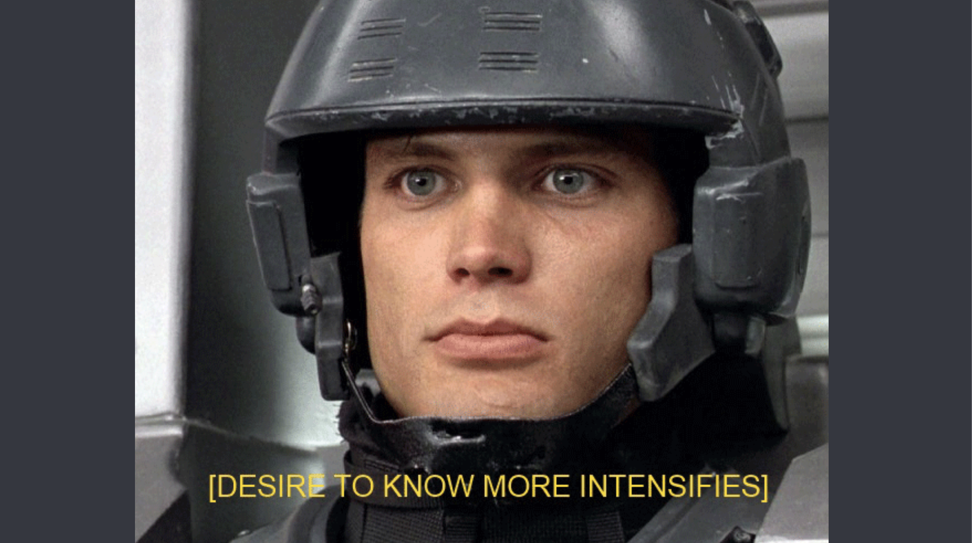
Notes:
Emergency slides

